Slide 1

Click the speaker graphic on each slide for audio

Slide 2
What is the purpose of the
“Stories for Children that
Grownups can Watch” project?
Help start a conversation between a
parent or caregiver and child
Raise awareness among social service
providers and other practitioners
Provide more information for healthcare providers; educators, attorneys and judges

Slide 3
What is childhood trauma?
The experience of an event by a child that is emotionally painful or distressful which often results in lasting mental and physical effects.
Event – One time or chronic
Experience – Experienced as scary or threatening
Effects – Long-lasting and life altering

Slide 4
What are the lasting effects
of exposure to trauma and violence?
Impacts brain development
Affects cognitive development and behavior
Interrupts the ability to learn

Slide 5



lookthroughtheireyes.org

Slide 6



lookthroughtheireyes.org

Slide 7

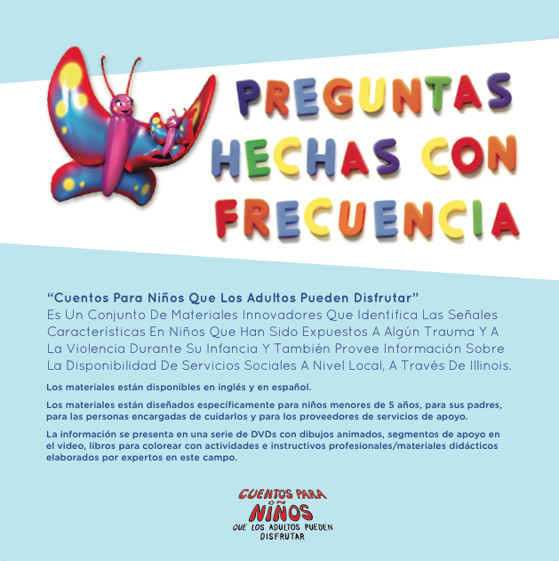



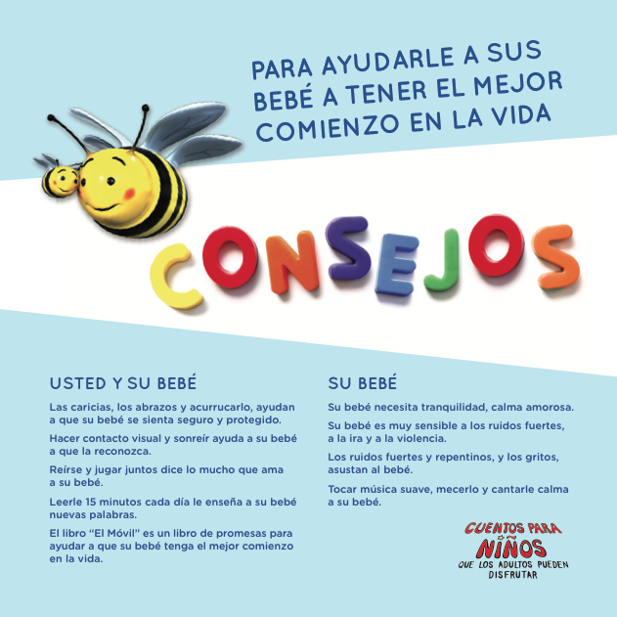
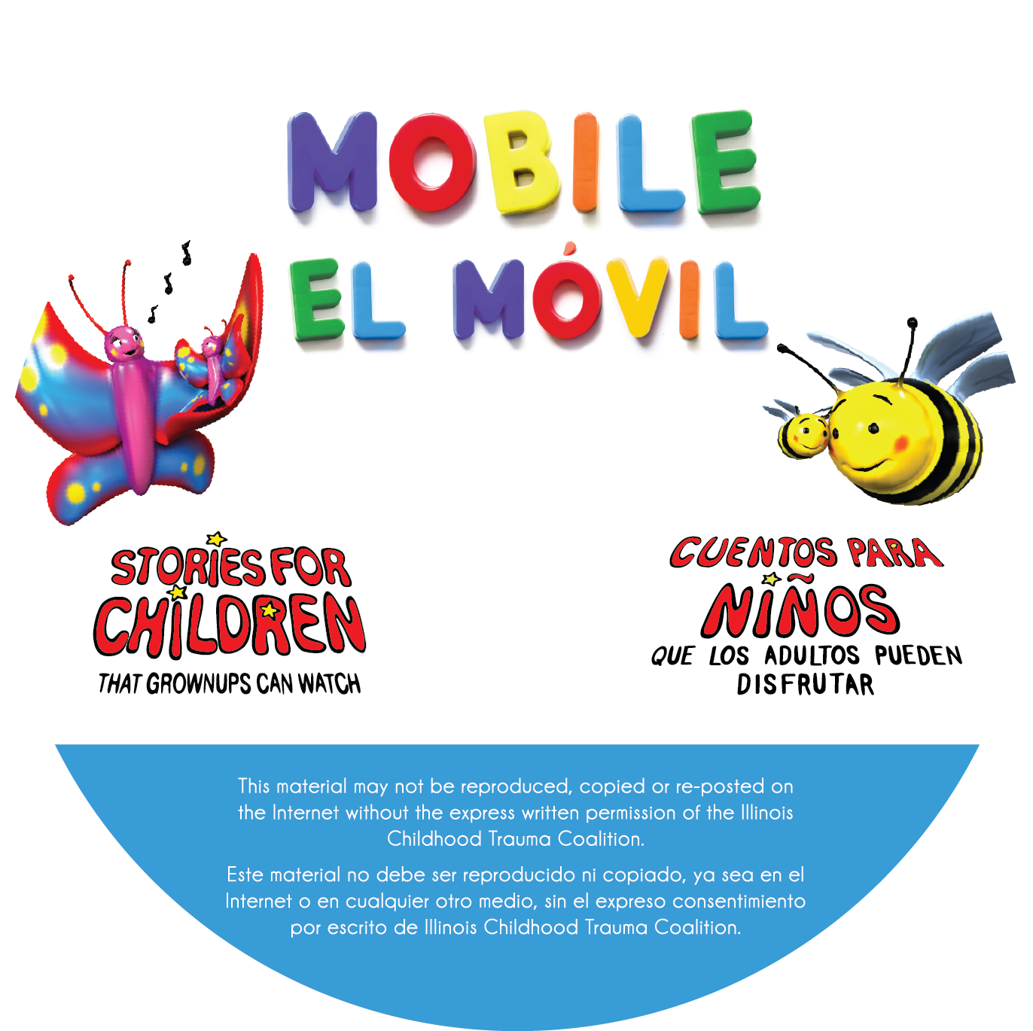
lookthroughtheireyes.org

Slide 8
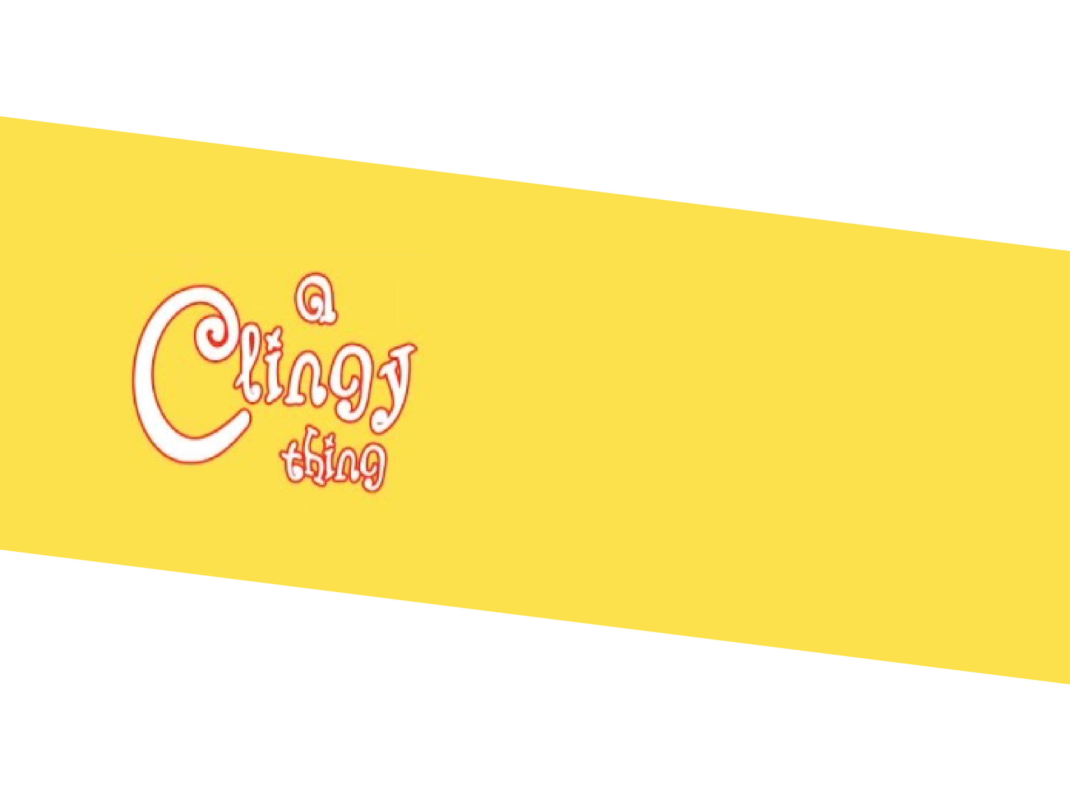

lookthroughtheireyes.org

Slide 9



Slide 10
To view “Help is Here” and “A Clingy Thing:” click on the link below.
Return to this slide and click on it to continue the presentation.
English - https://www.youtube.com/watch?v=rnWkVpBWBrk
Spanish - https://www.youtube.com/watch?v=q5PNER-NVhc

Slide 12
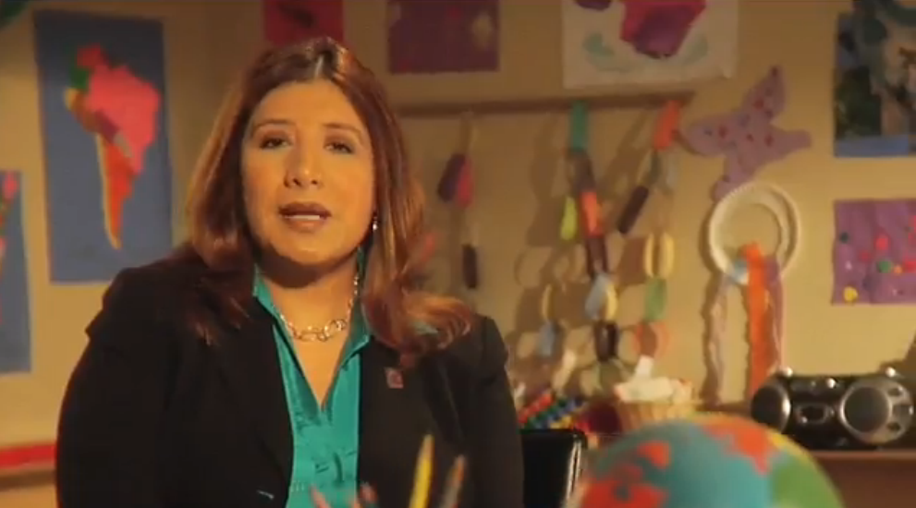
Maria Pesqueira
President & CEO, Mujeres Latinas en Accion

Slide 13
Anger & Arguments

Slide 14
Psychological First Aid

Slide 15
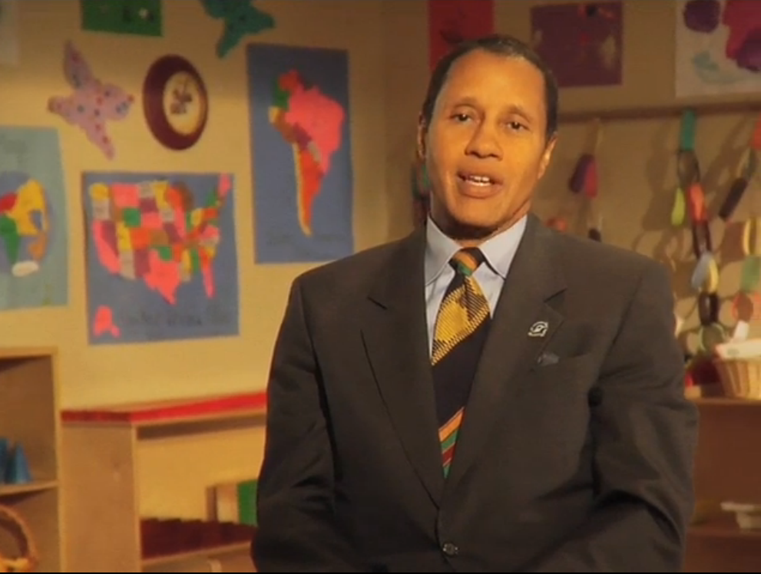
Carl Bell
MD, PhD, Clinical Psychiatrist,
Jackson Park Hospital,
Stories Project Clinical Mentor
Clinical Commentary and Training

Slide 16
Conflict Resolution

Slide 17
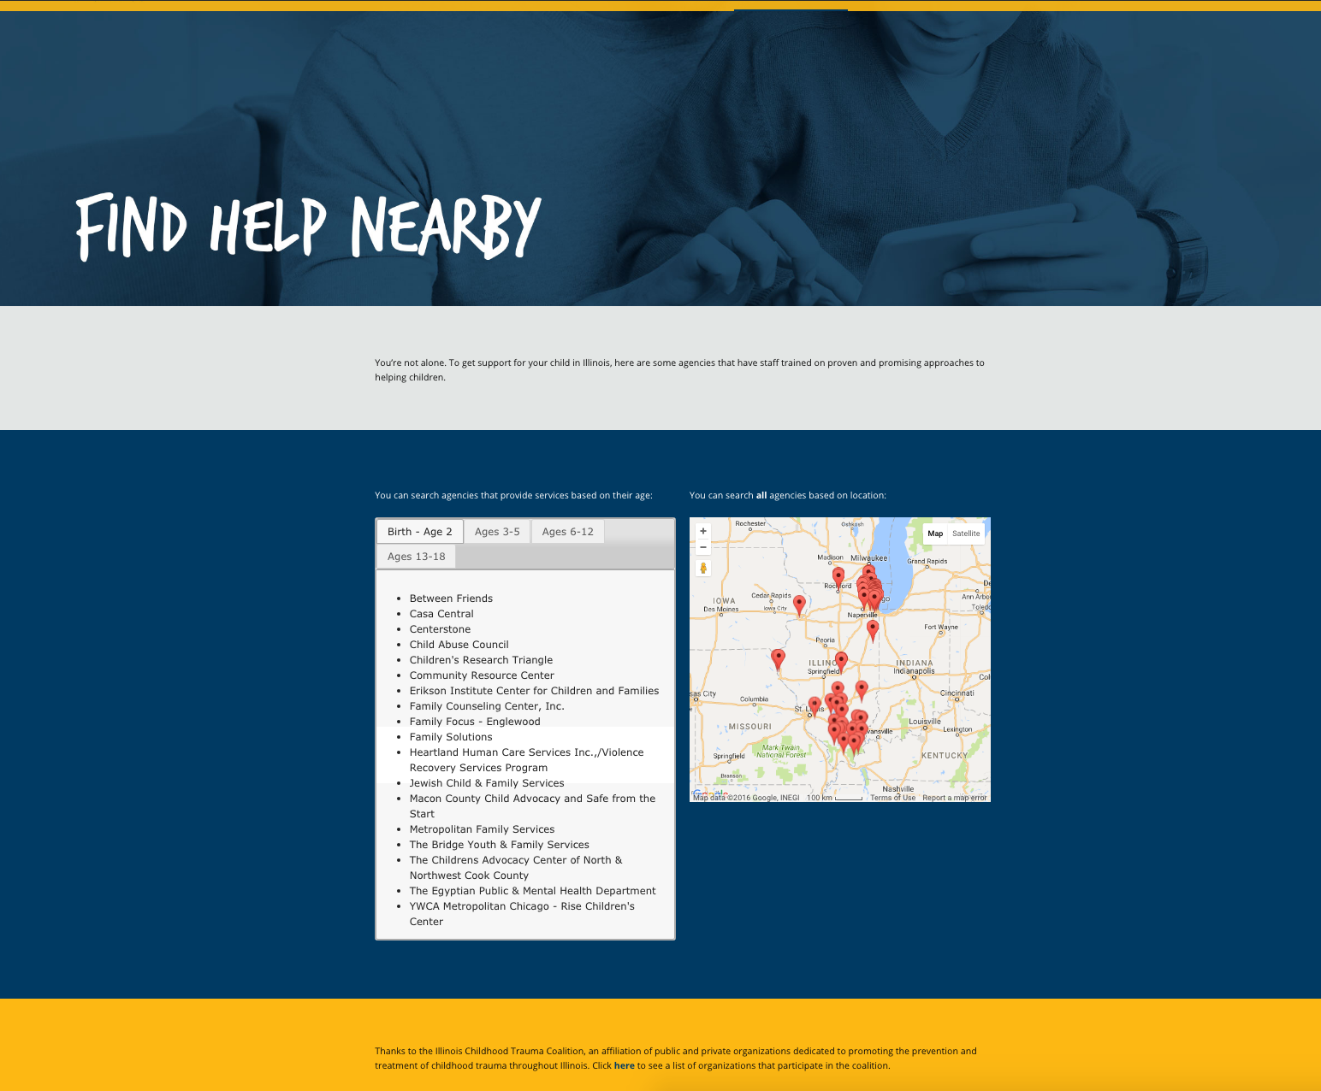

Slide 18
A Clingy Thing is dedicated to the memory of
Sylvia Adams
By creating A Clingy Thing and the Stories Project films
you helped to heal countless children and families,
inspiring us all in this important work.
We thank the following for funding A Clingy Thing:
Illinois Department of Children and Family Services
Illinois Violence Prevention Authority

Slide 19
Webinar materials developed collaboratively by
Illinois Justice Project
Esther Franco-Payne, Deputy Director
Chairperson of the Stories Committee,
Illinois Childhood Trauma Coalition
Illinois Childhood Trauma Coalition
Anne G. Studzinski, Managing Director
PS&A Communications
Sylvia Adams Creative Director
Phil Adams, Strategic Director
Linda Garland, Executive Producer
Tim Delaney, Art Director
Cultural Communications, LLC
Queta Rodríguez Bauer, Principal
Illinois Criminal Justice Information Authority
Reshma Desai, Special Projects Program Advisor
Office of Violence Prevention, Chicago Department of Public Health
Marlita White, Director and Narrator
Additional production support provided by
Ounce of Prevention Fund

